Slide 1

Logical Increments
FullStory Test Results
Yisela Alvarez Trentini
17.07.2018

Slide 2
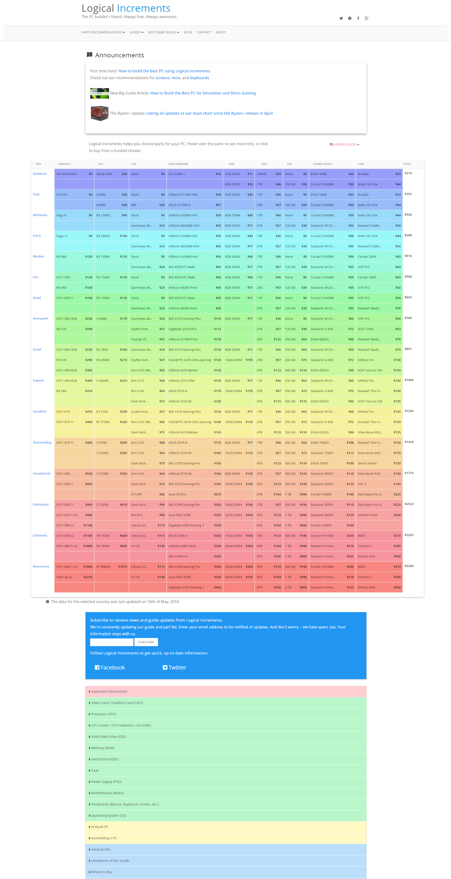
The Logical Increments Home

Slide 3
Test Specifications
Users 5,202 People (6,429 Sessions)
Test Settings Mouse Tracking Clicks Scrolling Speed Session Length Active Time Dead Clicks
https://app.fullstory.com/ui/D2KX8/segments/everyone/people/0

Slide 4
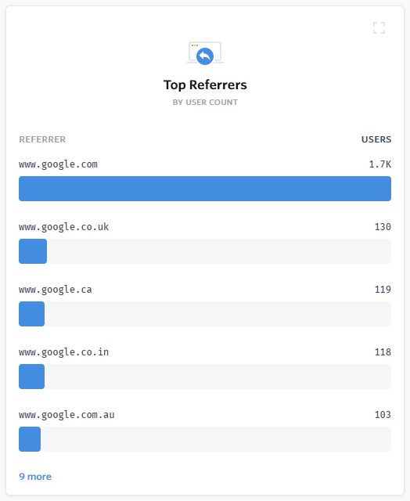
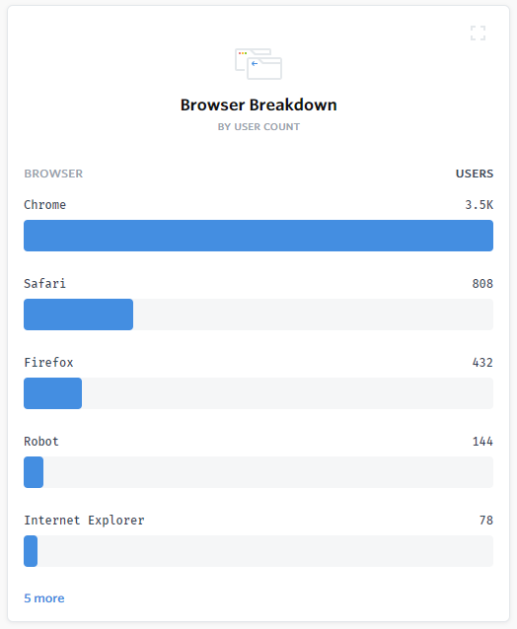
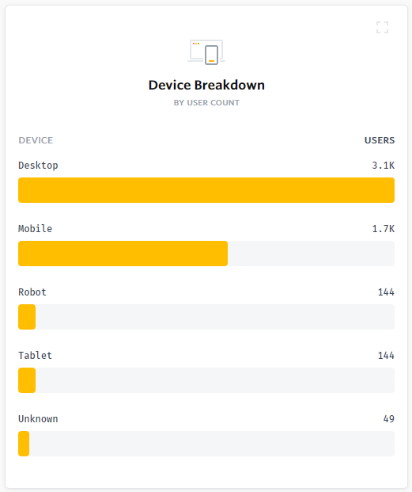
Findings Overview
Referrers, browser and device breakdown:

Slide 5
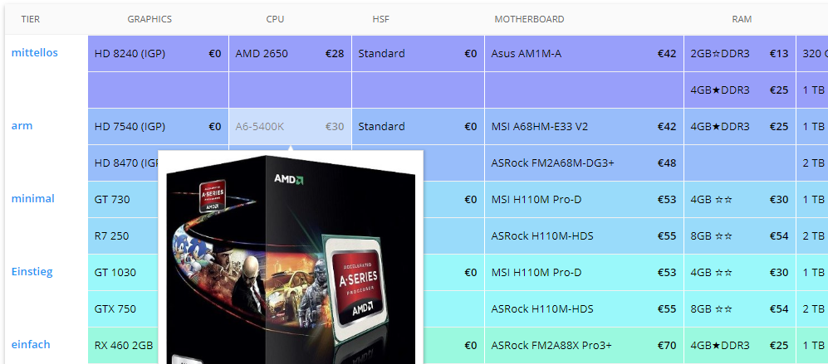
Findings: Table Comparison I
For several users, the comparison between products in the parts table is done by moving the mouse vertically or horizontally.
The modal design prevents this from happening smoothly. Users move the mouse, the modal covers the product name, they move the mouse out and try again.
Example: user 5029, 5182 (can’t compare), 5348 (0:40 can compare column), 5511 (can compare rows)

Slide 6
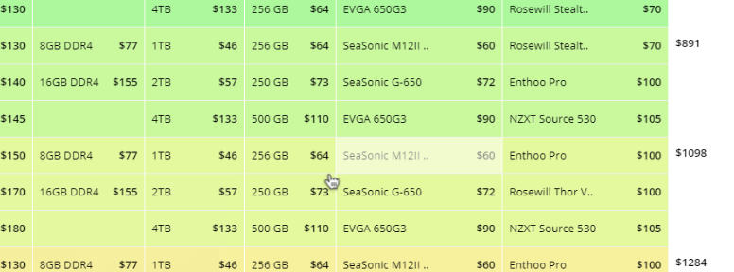
Findings: Table Comparison II
Some users seem to use the mouse cursor to “mark” where they are (column, row) as they explore the table. However this triggers the modal, so there is a “conflict” between using the mouse and not covering important information.
Example: user 5646

Slide 7
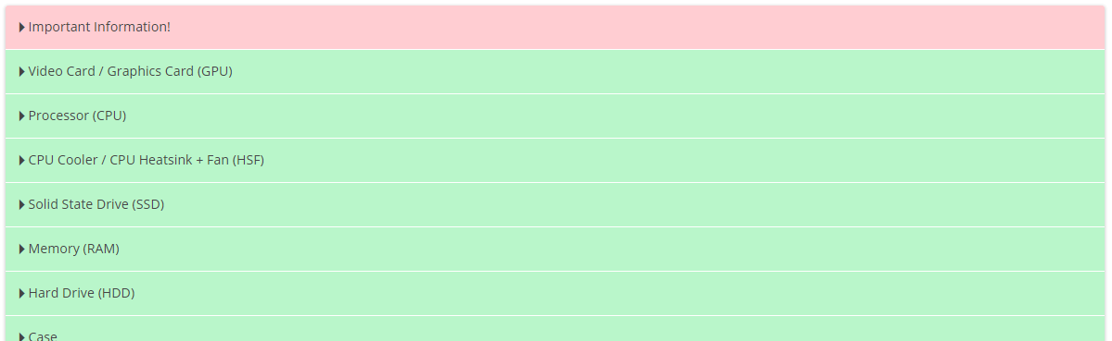
Findings: Information Expanders
Most user seem to understand how the expanders at the bottom of the table mean, and use them correctly. They scan the content using headlines as anchors. Some more formatting would benefit the scanning - inclusion of images, titles, bold text, etc.
Example: user 5045

Slide 8
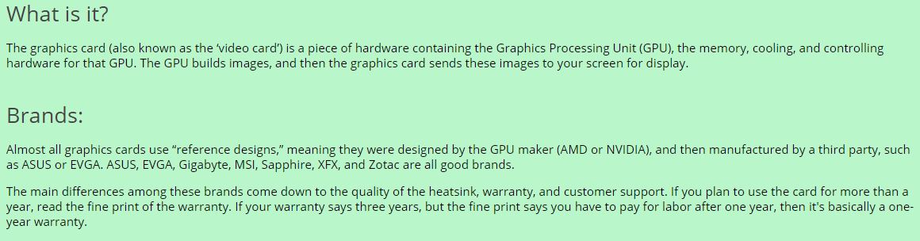
Findings: Text Scanning
In general, users that have a goal (for example look for certain parts) seem to scan text quickly looking for relevant information. This reinforces the need for more text formatting and shorter line widths.
Example: user 5045, 5087

Slide 9
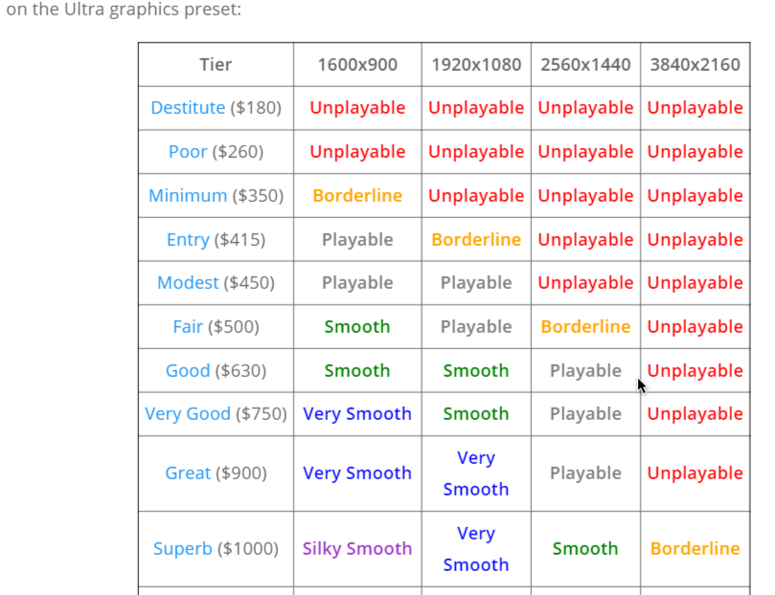
Findings: Tier Reference
Users that explore Game Builds and check the tables need to go back and forth to the home to see what tier is better for the game.
This is a good opportunity for linking the Tiers directly to the table with an anchor, so the user knows exactly where they are.
Example: user 4999, 3024

Slide 10
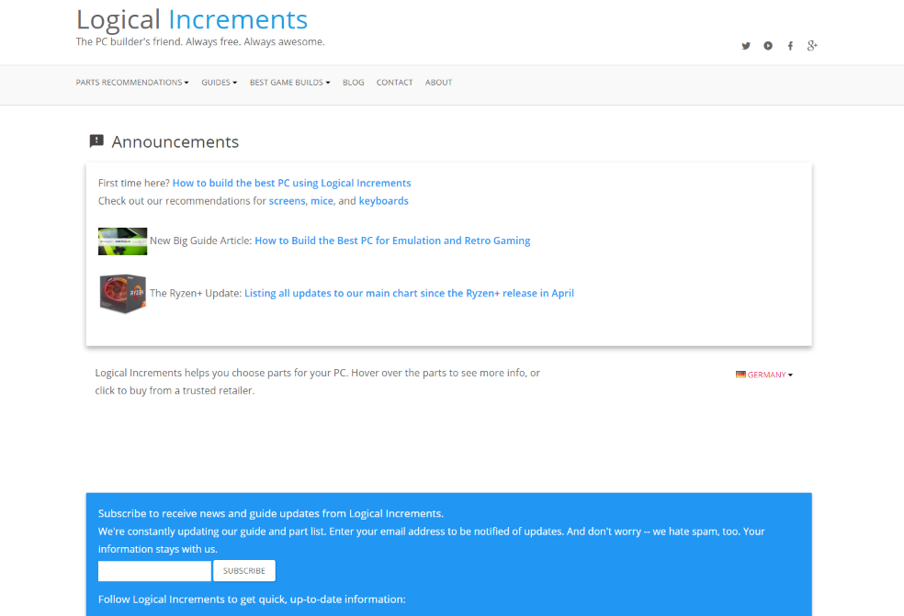
Findings: Missing Table
If the connection is slow, the parts table doesn’t load in time and some users scroll past it without realizing something is going to appear.
Example: user 4536, 4963, 5517

Slide 11
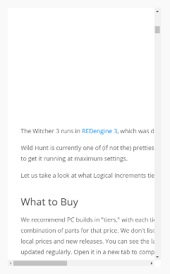
Findings: Mobile Issues
Mobile users seem to have struggled to understand and use the table, and some instances on the menu. A lot of scrolling, up and down and sideways, or losing the context of what they were exploring.
The same issue appears on some game pages, where the text is too long and doesn’t adjust to the screen size.
While the table requires more changes to be “fixed”, the game page should adjust with minimum changes needed.
Example: user 5088 (Home), 5042 (Game)

Slide 12
Findings: Clicking on Table
At least one user tried to click on the price in the Parts Table, although it contains no link.
Example: user 5089

Slide 13
Conclusions
It’s noted that users:
Generally struggle with the size of the parts table;
Sometimes don’t see the table because they scroll too fast;
Seem to (at least at first) be disturbed in their workflow by the parts table modals, although they apprently do much better once their behavior is learned - still some covering issues;
Rely on scanning (in this case mostly written) information to fulfill a goal (finding a part or build);
Read a lot (long sessions with little mouse movement);
Are generally engaged by images and tables;
Sometimes can’t see the menu or scroll past it fast (this is consistent with eye tracking findings), but the labels are easy to understand, as evidenced by the many direct clicks (the goal is fulfilled).

Slide 14
Thank You!

